Slide 1

TEXT ENCRYPTION USING VARIOUS ALGORTHIMS
S SIVA KARTHIK REDDY 2010030329
E.R SUAMANTH 2010030051
K SNEHITH 2010030341M

Slide 2

Abstract
This presentation contains the details of the project ‘text encryption using various algorithms’.
Text-encryption is a process in which the message send by the sender is encrypted so that only receiver can understand the message.
Encryption converts data into scrambled text. The unreadable text can only be decoded with a secret key.
The decoded text can be read by the receiver which maintains the security

Slide 3
METHODOLGY
Diffie–Hellman key exchange
Diffie–Hellman key exchange is a method of securely exchanging cryptographic keys over a public channel.
It was conceived by Ralph Merkle and named after Whitfield Diffie and Martin Hellman it was published in 1976.
It is one of the earliest known public work that proposed the idea of a private key and a corresponding public key.

Slide 4
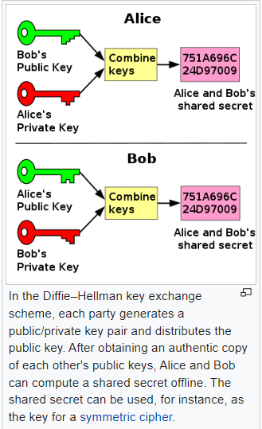
Diffie–Hellman in nutshell

Slide 5
ALGORTHIM
1.The first party picks two prime numbers, g and p and tells them to the second party.
2.The second party then picks a secret number (let’s call it a), and then it computes gª mod p and sends the result back to the first party; let’s call the result A. Keep in mind that the secret number is not sent to anyone, only the result is.
3.Then the first party does the same; it selects a secret number b and calculates the result B similar to the
4.step 2. Then, this result is sent to the second party.

Slide 6
5. The second party takes the received number B and calculates Bª mod p
6. The first party takes the received number A and calculates A^{b} mod p

Slide 7
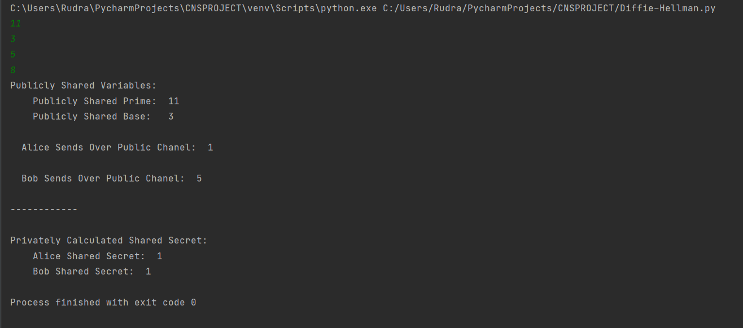
Output

Slide 8

THANK YOU

